Slide 1


ARTIFICIAL
INTELLIGENCE
Presented by Bakytbekova Bayana cs-25-24

Slide 2
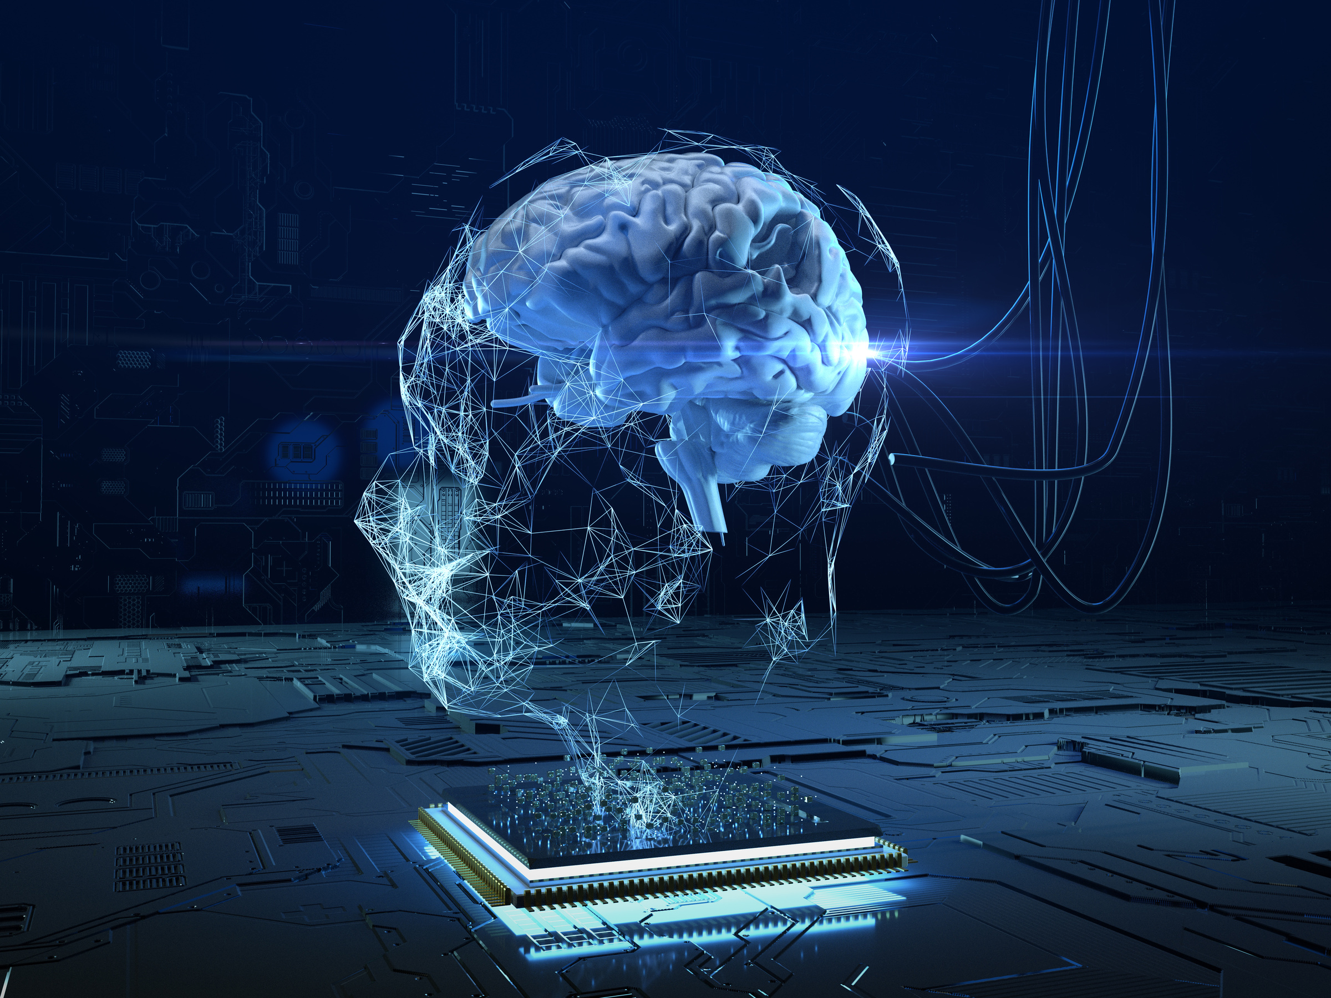
5 AI APPLICATIONS
Runway
Slyp
Notion AI,
JukeBox
Alice

Slide 3

Runway
is an AI platform for creative tasks. It has tools for video editing, image generation, and animation using neural networks. It is used in movies, design, and content creation.
How it work?
For example we have a video with a person we want to remove. AI analyzes the scene, removes the object, and restores the background.
RUNWAY
AI detects object boundaries.
the program removes the object.
the neural network fills the empty space by analyzing surrounding areas.
✅ Deep Learning – helps AI analyze videos and images.
✅ Computer Vision – recognizes objects, people, and backgrounds.
✅ Generative Models (GANs, Diffusion Models) – create new images and videos.

Slide 4

Slyp
is a service that helps users manage digital receipts and payment data. It automatically processes purchase information.
How it work?
For example we pay for coffee with a card, and the receipt automatically appears in the app.
Slyp
slyp connects with API.
the program extracts details like amount, store, and date.
the receipt is saved in the profile.
✅ Optical Character Recognition (OCR) – reads text from images.
✅ Machine Learning – analyzes spending habits and sorts receipts.
✅ Banking APIs – connects to banks to collect digital receipts.

Slide 5
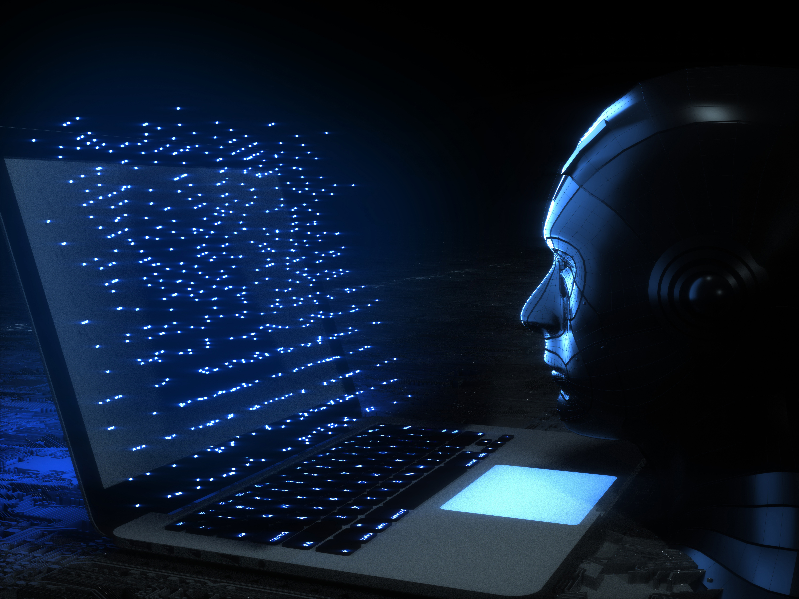
Notion
uses GPT-4 to generate, analyze, and improve texts.
How it work?
For example we write “Summarize this article,” and AI creates a short description.
ai understands the content.
extracts the most important ideas.
writes a concise and logical summary.
Notion
✅ Natural Language Processing (NLP) – understands and analyzes text.
✅ Deep Learning – learns from large text databases.
✅ GPT Model – a powerful AI for generating and editing text.

Slide 6
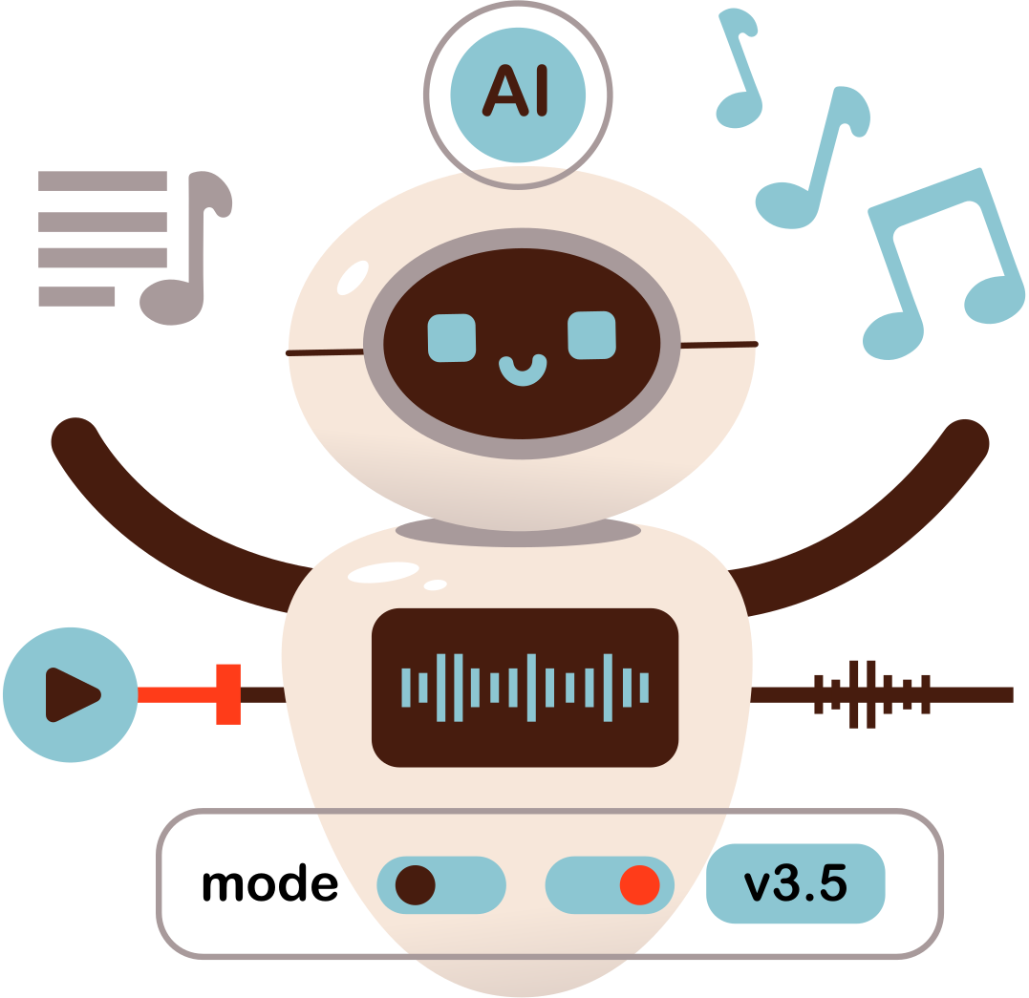
JukeBox
generates music and vocals by learning from thousands of songs.
How it work?
For example AI can generate a voice similar to your favorite singer.
AI learns singing techniques.
creates lyrics and melodies.
✅ Deep Learning – analyzes and creates complex musical structures.
✅ Generative Models (GANs, Transformers) – help AI understand and reproduce different music styles.
✅ Spectrograms – AI analyzes sound as an image to recreate melodies and voices.
JukeBox

Slide 7

Alisa
Alice understands speech, analyzes requests, and responds with a human-like voice.
How it work?
Alisa
For example we say “What’s the weather like?” and Alice understands and replies.
AI converts voice into text.
analyzes the phrase using NLP (Natural Language Processing)
✅ Speech Recognition – converts voice into text.
✅ Natural Language Processing (NLP) – analyzes and understands text.
✅ Deep Learning – learns from conversations and becomes smarter.

Slide 8
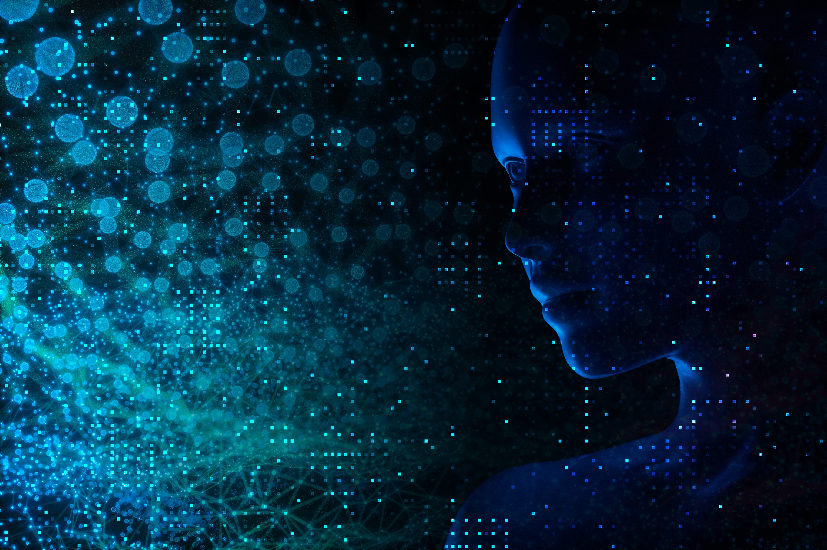
Thank you!

